Slide 1
4.1.2 Social Media Image Recontextualization

Slide 2
Problem Statement
There’s an article, and then there are posts which may or may not be recontextualized.
The fact checking of the article is not important. Ground Truth – Articles.
The images remain the same in both article and post.
Each post contains a narrative. It makes the post lean toward or agree with a specific agenda.
Narratives- (1) Pro Russia/Anti Ukraine and (2) Pro Ukraine/Anti Russia
Intents: Call to Action and Demoralization
Narratives and Intents – Not important for Evaluation – Data Structure Information
Article Important info - Headline, Caption or Body
Posts will be limited to Twitter length but not be representative of in the wild Twitter posts.
Image Recontextualizations- Image is same, it is taking an image and classifying, labeling,or stating that the image is of something that it is not (event, location, individual, group, etc.)
Recontextualization types- event, location, or individual/groups

Slide 3
Each article has consistent and recontextualized posts. The posts have images and text.
Consistent Posts- No Intent, same/consistent narrative
Recontextualized Posts- There is intent and an alternative ‘recontextualized type’ narrative here (which is not scored)
Consistent Post Reference Types- News Agency Post and Human Commentary with no Intent/Tactic Social Media Post
News Agency Posts- Consistent, no opinion unless quoted.
Human Commentary – Paraphrasing, expressing a feeling, emotion and opinion is present but still accurate/consistent
Recontextualization Types –
Event Recontextualization refers to mischaracterization of an event such as a bombing/explosion or a riot or protest.
Location Recontextualization refers to refers to the specific area or place that something happens such as a country, city, or place within a city (capital building, hospital, etc.).
Individual/Groups Recontextualization refers to inaccurate representation of individuals such as notable politicians or doctors or to individual/entities/groups of people such as protestors, rioters, civilians, soldiers, etc.
Social Media Post - contain three sentences, a single (1) recontextualization sentence, (2)intent/tactic sentence, and (3)narrative sentence. Sentences will be in random order.
The dataset contains – equal consistent human commentary and recontextualized posts.

Slide 4
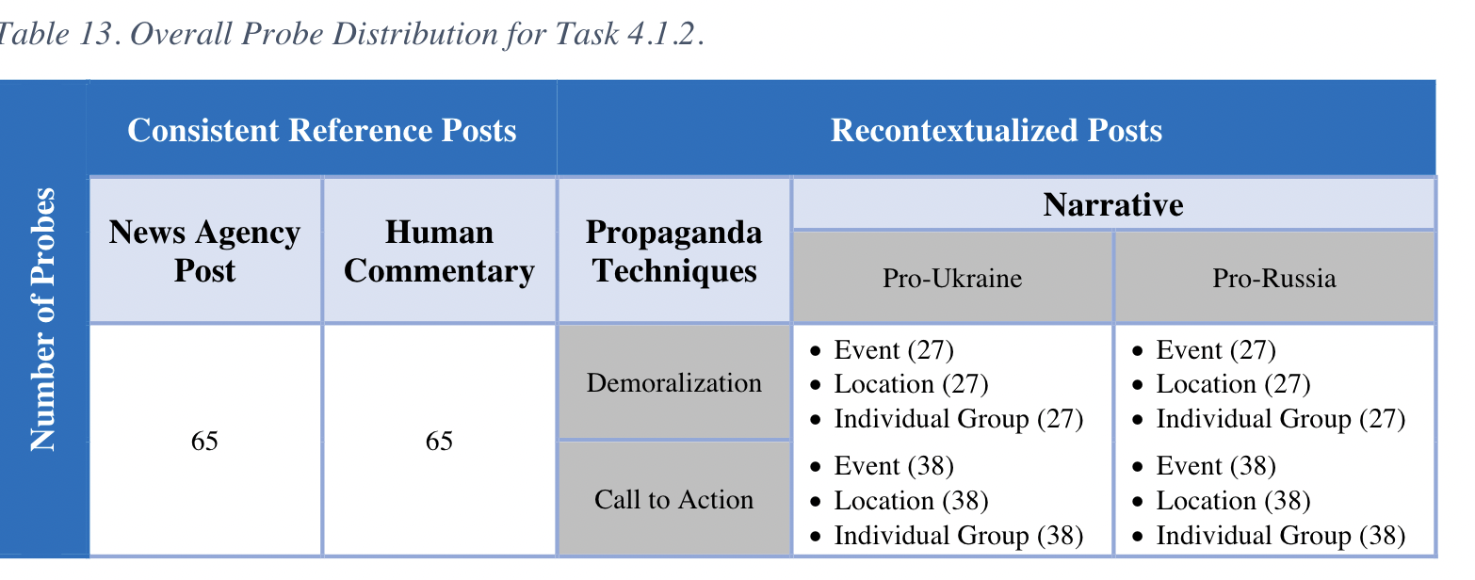

Slide 5
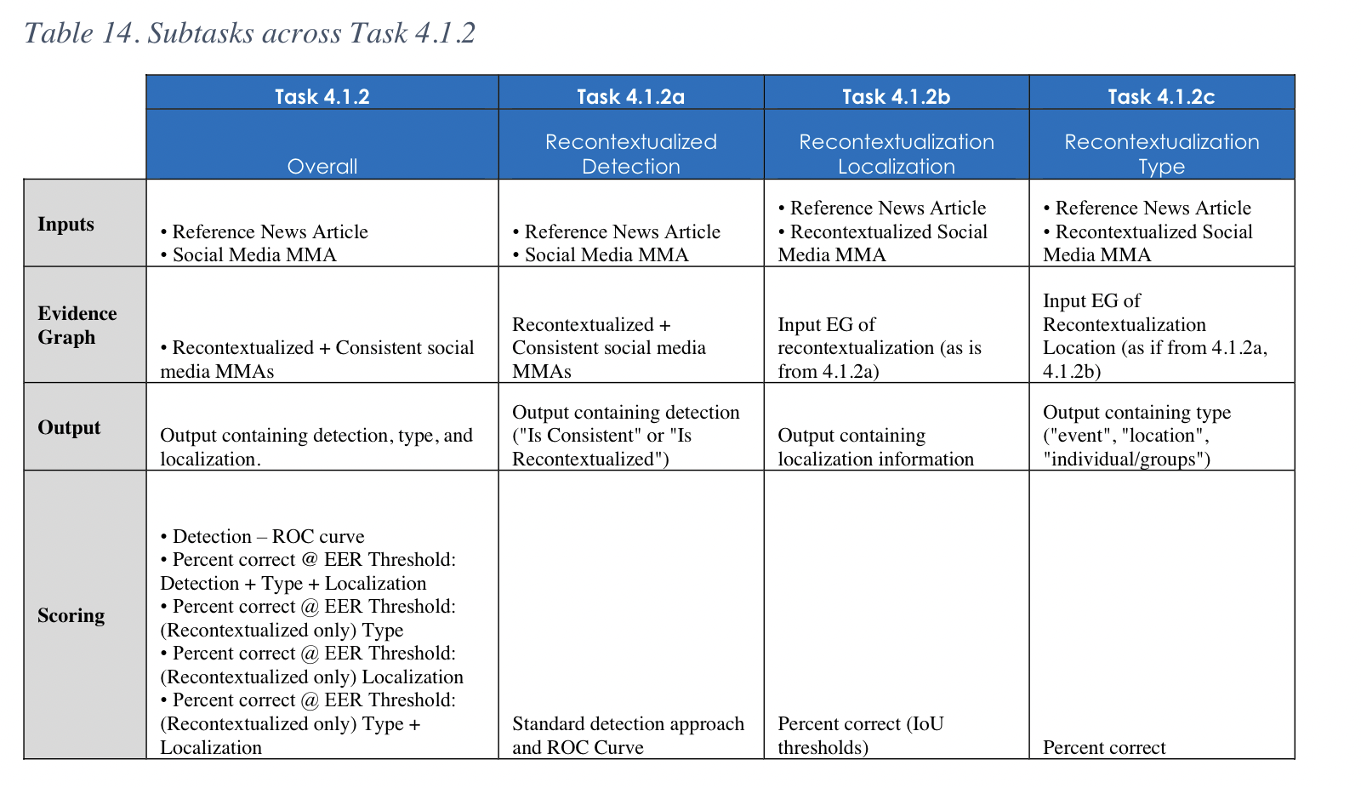
Scoring
Overall :
Preferred phrasing of output responses answers this way could make it so that we can string the answers together thusly,
“We believe this post
“is recontextualized”
“by event” because
“bombing spree” is...”.
Scoring across the overall task
and the three subtasks is defined
in the table below.

Slide 6
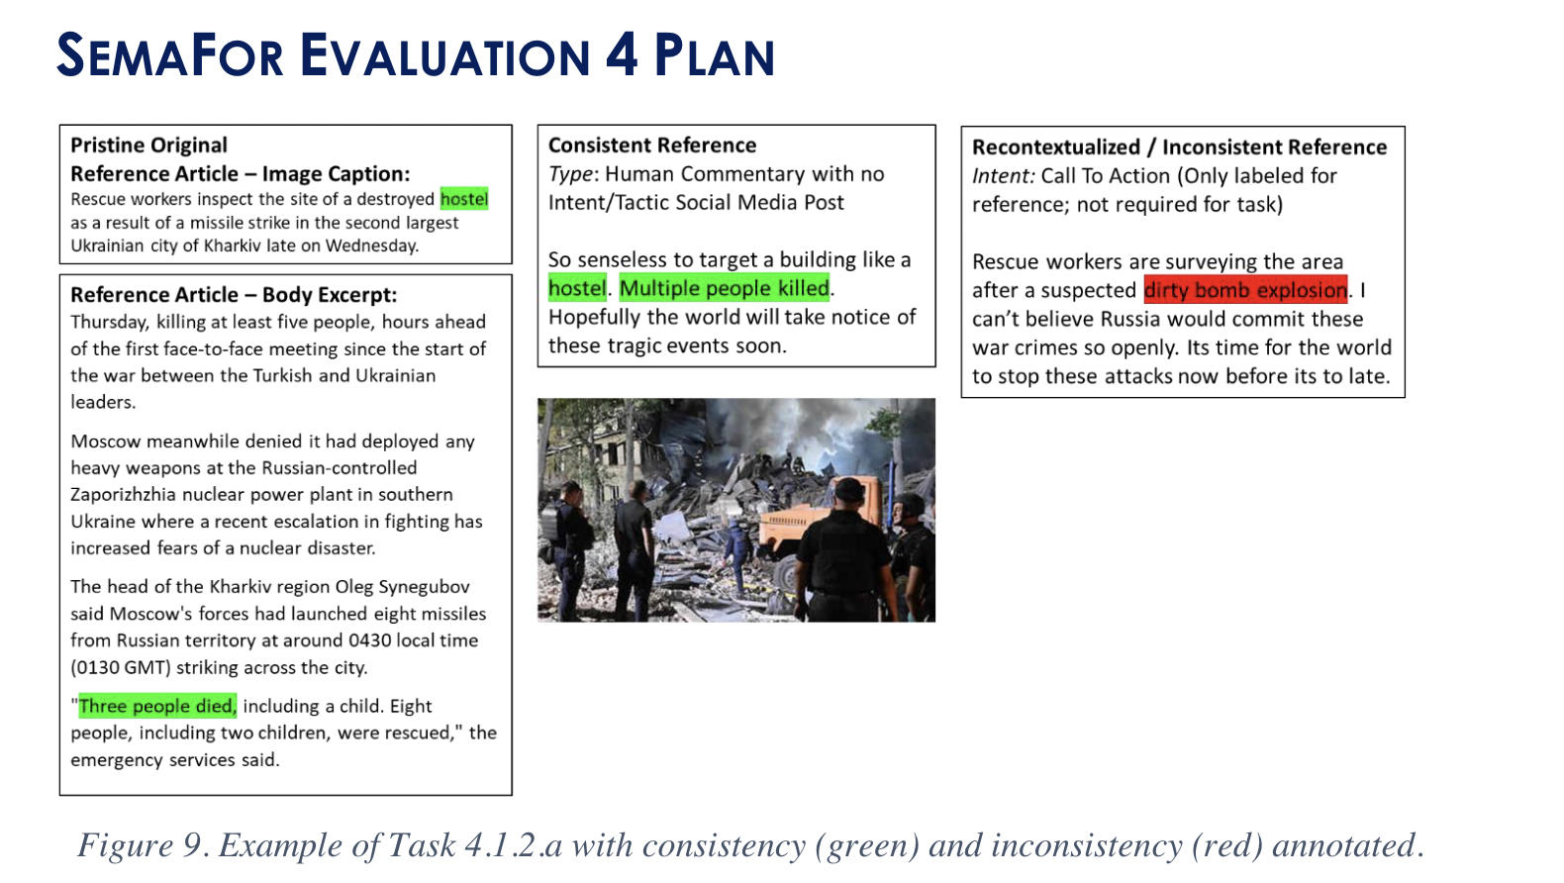
4.1.2.a Recontextualization Detection (D)
Consistent or not?
May need analysis of both post and article
for detection in some cases.
There seems to be a
location recontextualization
here, with a call to action
intent and anti Russia
narrative.

Slide 7
SemaFor Evaluation Plan
Input – 2 ArtifactGraphs: There are two ArtifactGraphs provided for analysis. These graphs likely contain structured representations of text, entities, and their relationships, allowing for detailed analysis. AnalyticScope: This identifies the reference news article, which serves as the basis for comparison and detection of recontextualization. The field "recontextualizationRef" specifies which of the two ArtifactGraphs is the reference article.
Output – Evidence Graph (result of detection)
LLR score (Log Likelihood of Recontextualization)
Target probes will contain recontextualized social media posts.
Non-target proves will contain consistent social media posts.
Binary classification metrics will be used for this task, similar to previous evaluations.

Slide 8
Pipeline
A module to detect Narrative (Check Narrative of both article and post, if they are same, then points added to consistent) – medium weightage
A module to detect Intent (Check the intent of only the post, if it is either one, then points added to recontextualized) – least weightage
A module to detect Recontextualization Type (Facts – If they are same, check both article and post, then consistent definitely)- Highest Weightage
If facts are inconsistent, then recontextualized, else, check intent and narrative.

Slide 9
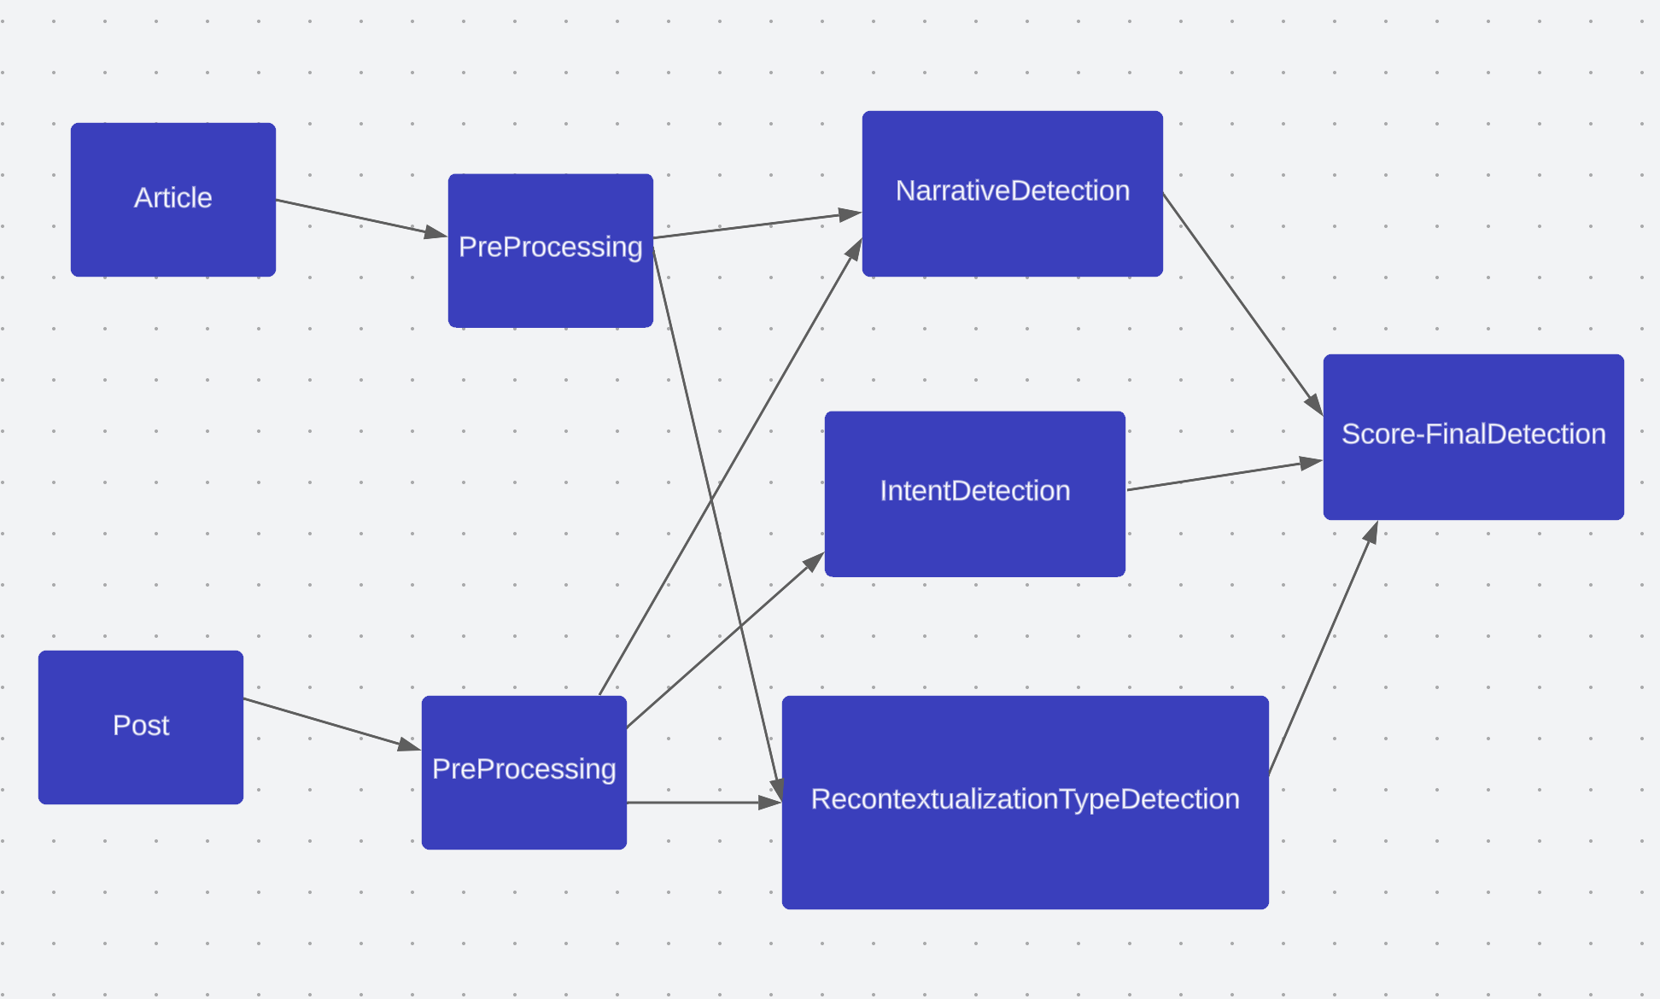

Slide 10
Recontextualization Type Detection
Find facts pertaining to location, individual, event of both – article and post. Compare facts, if all are same, pass check (Consistent).
Named Entity Recognition (NER): Apply NER techniques to identify and extract named entities such as locations, individuals, and events from both the article and the post. Pick one NLP library that provides pre-trained models for NER, such as spaCy, NLTK, or Stanford NER.
Entity Matching: Compare the extracted entities from the article and the post to identify similarities or matches. Use string matching algorithms, such as exact string matching or fuzzy string matching, to compare the entities and find commonalities.
Fact Comparison: After identification of the matching entities, compare the facts associated with those entities. This could involve analyzing the surrounding context or extracting additional information related to the entities, such as descriptions, attributes, or relationships. Utilise various techniques like keyword extraction, semantic similarity, string matching algorithms like Levenshtein distance or cosine similarity for entity matching or deep learning-based approaches to compare and match the facts.
Consistency Check: If all the facts pertaining to location, individual, and event are the same between the article and the post, (Can be used for Recontextualization Type Classification task) you can pass the consistency check and conclude that they are consistent. Define the conditions or criteria for passing the consistency check, such as requiring an exact match for all facts or allowing for a certain level of variation.
Note: If the facts are inconsistent, then it’s definitely recontextualized. However, if the facts are correct, then we check the Intent and Narrative.

Slide 11
Narrative Detection – Open to suggestions
Find narratives of both – article and post. Compare. If similar, pass check (Consistent).
Named Entity Recognition (NER):
Apply NER techniques to identify named entities such as countries, including Russia and Ukraine, within the article and the post. NER models like spaCy or NLTK can be used for this task.
Sentiment Analysis:
Utilize sentiment analysis techniques to determine the sentiment polarity of each sentence. Use pre-trained sentiment analysis models or libraries such as VADER or TextBlob.
Keyword Extraction:
Extract keywords or phrases related to negative sentiment or criticism towards Russia and Ukraine from the sentences. This can be achieved through rule-based approaches or by utilizing pre-defined lists of keywords.
Anti-Russia or Anti-Ukraine Identification:
Analyze the presence of the extracted keywords or phrases within the sentences to identify if there is a negative sentiment specifically targeted towards Russia or Ukraine.

Slide 12
Intent Classification/Detection
Find intent of post. Compare with classes – Call to Action/Demoralization/None. If latter, pass check (Consistent).
Intent Classification: Train or Use a pre-trained classifier model to classify the intent of each sentence. Will need a labeled dataset where each sentence is labeled as Call to Action, Demoralization, or None. Use various machine learning algorithms such as logistic regression, SVM, or deep learning models like RNNs or transformers to build the classifier.
Scoring: Assign a score to each sentence based on its predicted intent class. This can be done by calculating the probability or confidence score of the classifier for each class.
Comparison: Compare the scores of all the sentences in the post. If there is a sentence with a high score for either Call to Action or Demoralization, mark it as the sentence reflecting the intent. Will help in Recontextualization Localization. If none of the sentences have high scores for these classes, consider the post as having the intent of None.
Score it for Overall Detection Task.
Note: An Opinion (Human Commentary) might be an intent, and can lead to misclassification of the post, to recontextualized, instead of consistent, which it actually is. Hence, less weightage must be given to this module.

Slide 13
Pros
Saves time needed to create a dataset, only need a dataset for call to action or demoralization classes.
Can be generalized to any news article, instead of just polarizing political ones like Ukraine- Russia (and just these two countries in specific).
Fairly simpler, due to using pre-trained models, instead of creating a model from scratch.
Can be easily extended to perform localization and classification of Recontextualization Type tasks.

Slide 14
Timeline – Diksha
Tasks | Date
Come up with a Basic Pipeline for the Model | July 16th
Get a Baseline Model ready | Aug 5th
Learn about the SemaFor Framework – Evidence and Artifact Graphs and Submission Plan | Aug 11th
Set up Local Environment for Baseline Testing | Aug 17th
Evaluation Submission Testing | Aug 25th

